Slide 1
AdaBoostAlgorithm

Slide 2
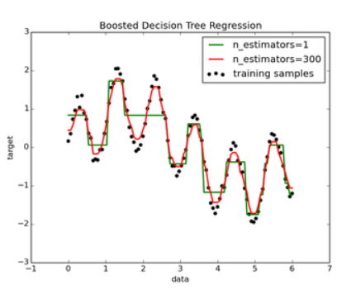
AdaBoostRegressor

Slide 3
What is AdaBoost regressor ?
An AdaBoost regressor is a meta-estimator that begins by fitting a regressor on the original dataset and then fits additional copies of the regressor on the same dataset but where the weights of instances are adjusted according to the error of the current prediction. As such, subsequent regressors focus more on difficult cases.

Slide 4
Parameters:
Estimator : object, default=None
n_estimators: int, default=50
learning_rate: float, default=1.0
Loss: {‘linear’, ‘square’, ‘exponential’}, default=’linear’
random_state: int, RandomState instance or None, default=None

Slide 5
Code:
from sklearn.ensemble import AdaBoostRegressor
Regressor=AdaBoostRegressor()
regressor.fit(x_train,y_train)

